Slide 1
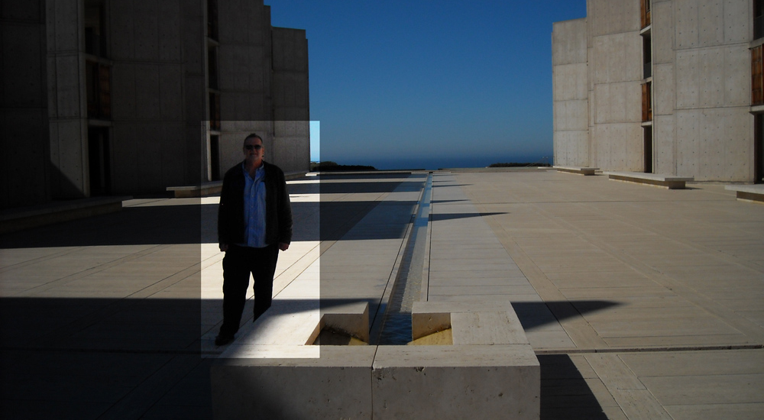
Ecological Issues
Site Visit 1 - Salk Institute
Dennis Selke
Spring 2014 – Instructor: Will Allen
Notes:
Photo by Marlene Selke 2/14/14

Slide 2
Located on the Pacific Coast
A short drive off of the I-5 and Genesee Av.
10010 N. Torrey Pines Road, La Jolla, CA 92037
www.salk.edu
The Kahn originals are two mirror image 6 story lab buildings
The buildings were specifically designed to be, simple, sturdy, light maintenance and a timeless work of art
Notes:
Photo by Dennis Selke 2/14/14

Slide 3
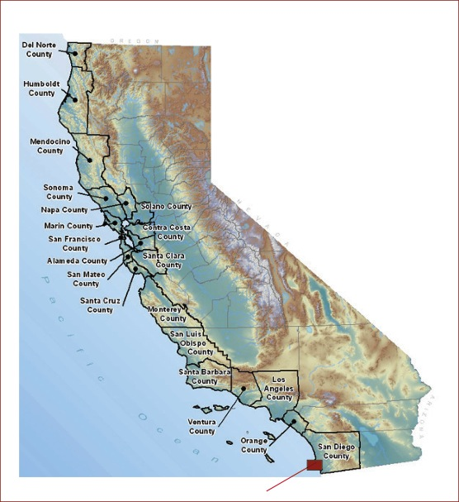
Location map
California
La Jolla
Notes:
Map from National Weather Service

Slide 4
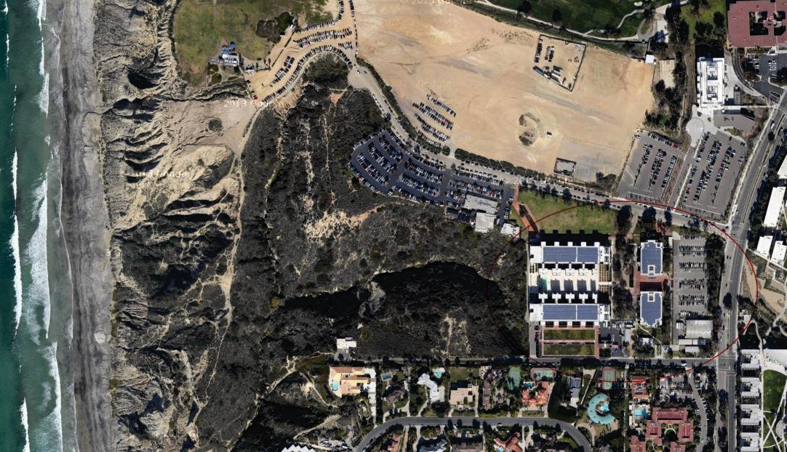
Site Photo
Salk Institute
Notes:
Image from Google Earth

Slide 5
Premiere Biological Research Facility
The Salk Institute was created by Jonas Salk, polio vaccine discoverer. The buildings were designed by Louis Kahn with consultations from Luis Barragan
10010 N. Torrey Pines Road, La Jolla, CA 92037
www.salk.edu
The Kahn originals are two mirror image 6 story lab buildings
Footnotes 2, 4, 5, 6, 7

Slide 6
Project Objective:
Understand those structures that incorporate old technology to achieve environmental sustainability
Footnotes 1,4

Slide 7
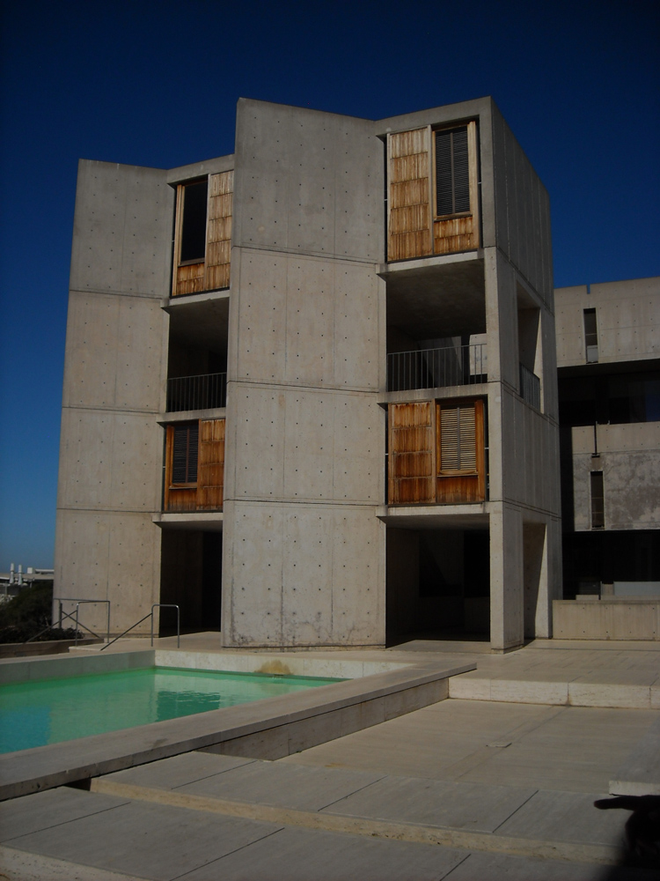
Professional Office towers
Primary Research scientist oak table rooms – places where the ideas for new biological treatments, procedures and processes are invented, discovered and brain stormed
Conflicting issues: a huge 6 story facility where everyone is thinking and collaborating on research projects. A lot of time and effort is needed, isolation needs to be addressed. The facility is designed to have common areas where people can casually meet and share ideas
Footnotes 1,4,5

Slide 8
Energy flow
Light is addressed with a masters touch of genius.
1960 was the year the buildings were started.
Kahn addressed the city height limits by sinking the structure into the bluff.
The lower basement has been configured to bring light into all lab spaces
Footnotes 3,6

Slide 9
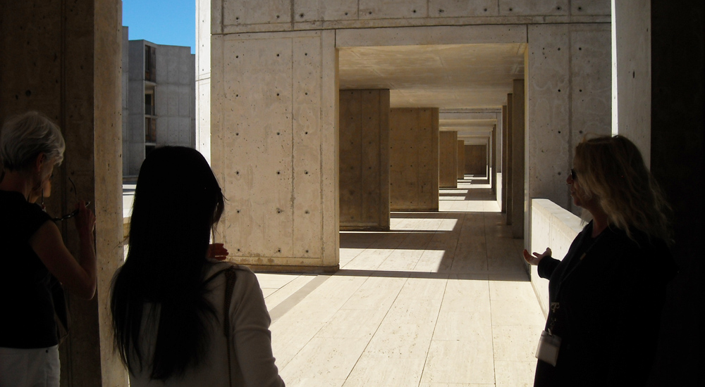
Proportion
While addressing light and air needs he also created a proportion which was careful and thought out. Vistas emerge while experiencing the building as a scientist would.
Footnotes 1,4,5,9

Slide 10
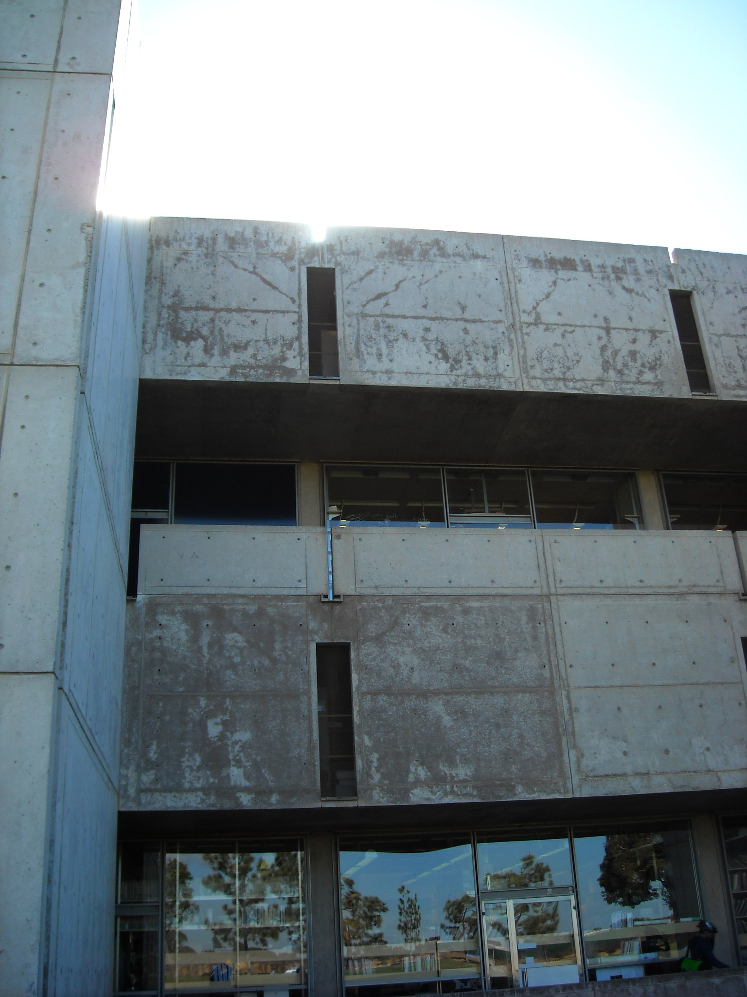
Heat is addressed through mass
The massive concrete walls and below ground connection to the Earth create a moderating factor, heating up in the sun of the day, releasing the heat in the evenings
Footnotes 1,3,5

Slide 11
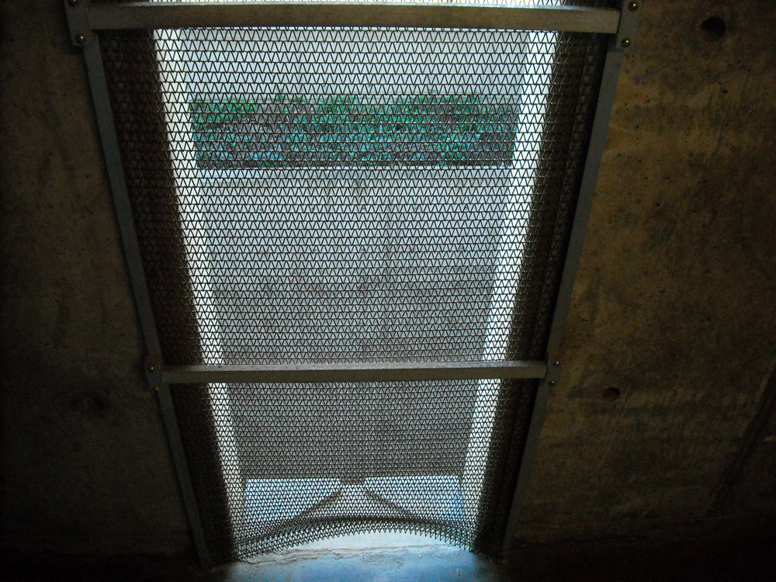
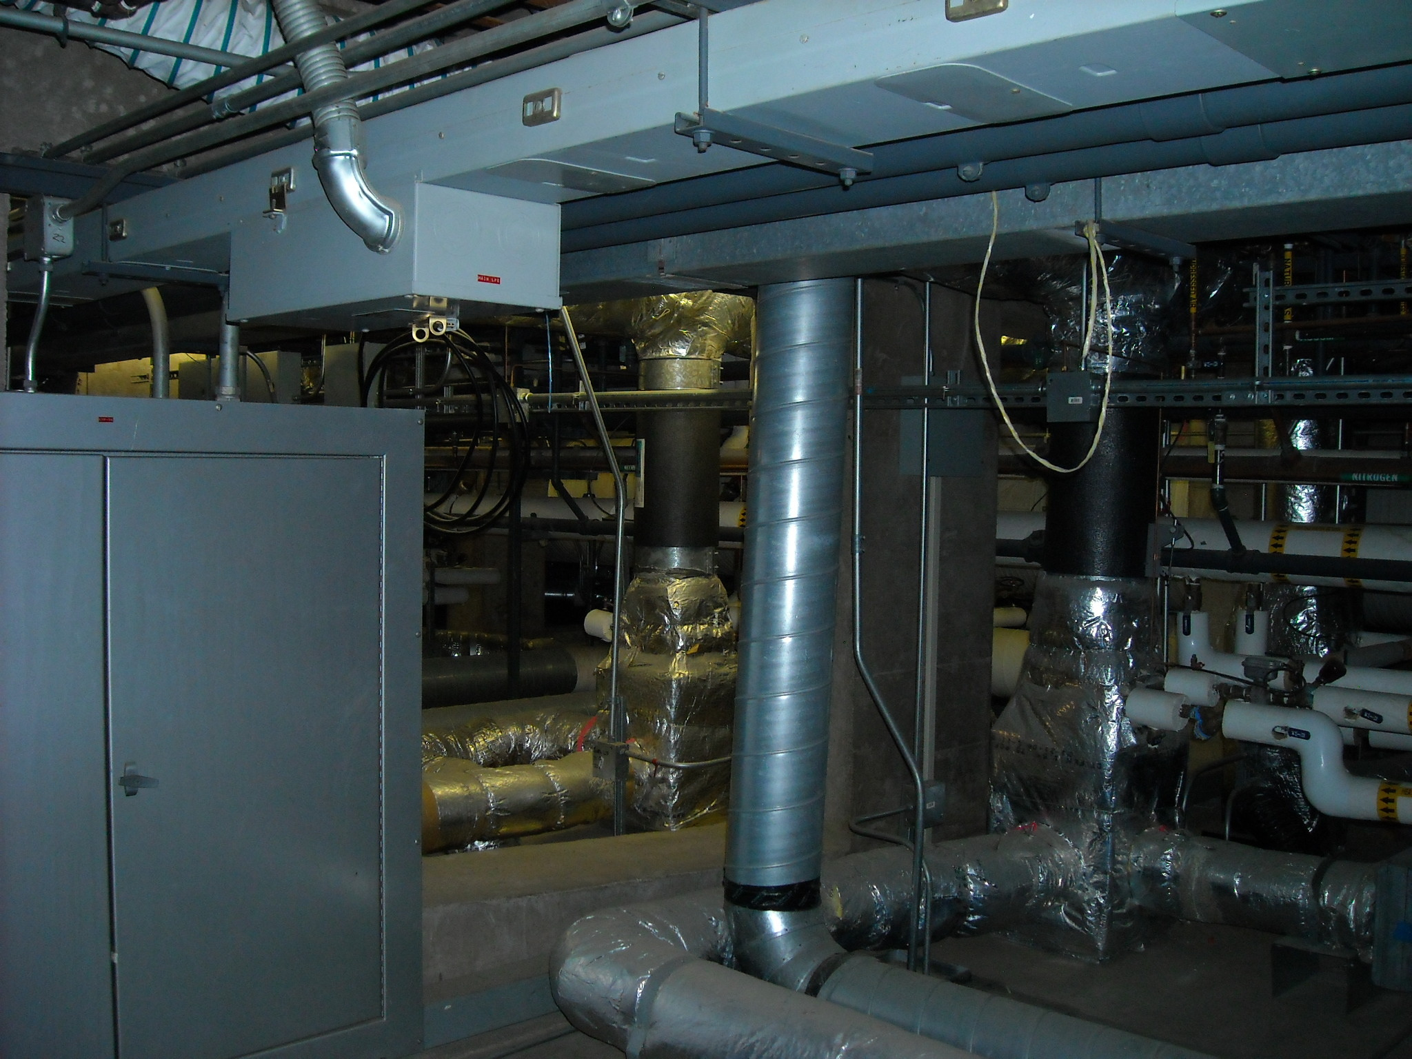
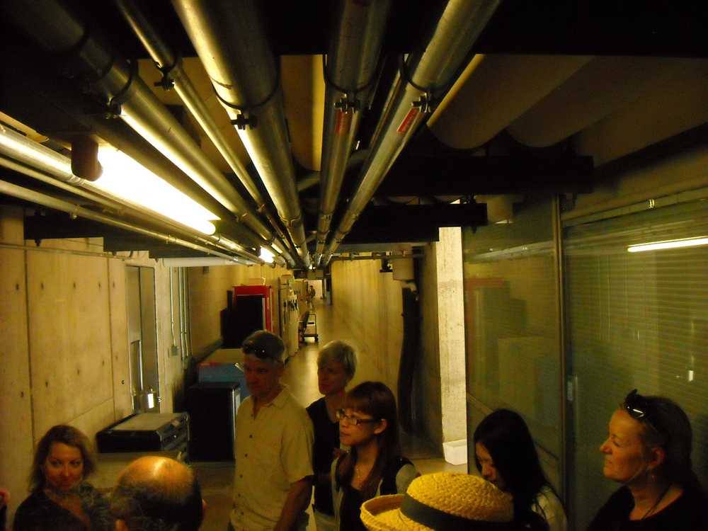
Air circulation
Due to being a lab it has massive air handling needs
Interstitial floors provide services anywhere that they are needed.
Post tensioned concrete Vierendeel trusses at 20’ centers provide column free lab spaces of 65’x245’ in each building. 3 working labs and 3 interstitial spaces in each building provide a place that researchers are proud to work in.
Footnotes 1,4,5,6

Slide 12
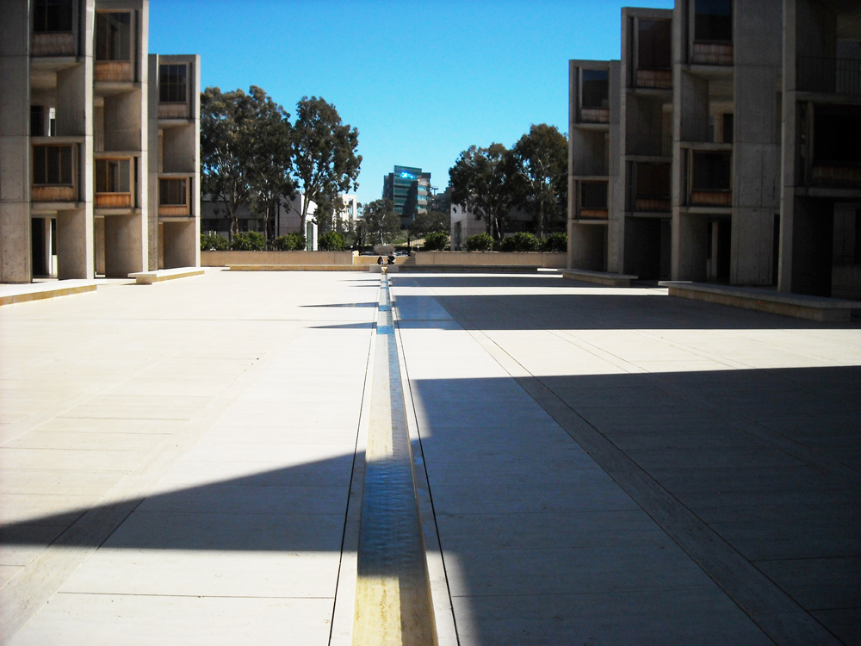
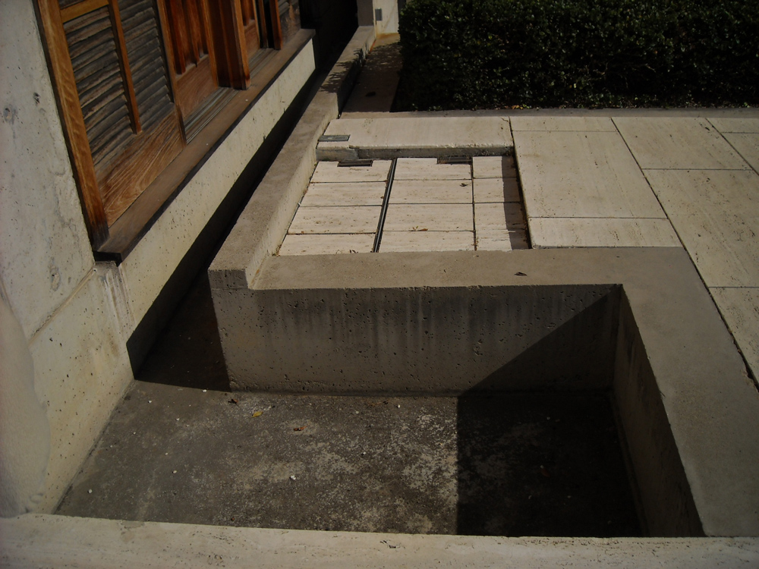
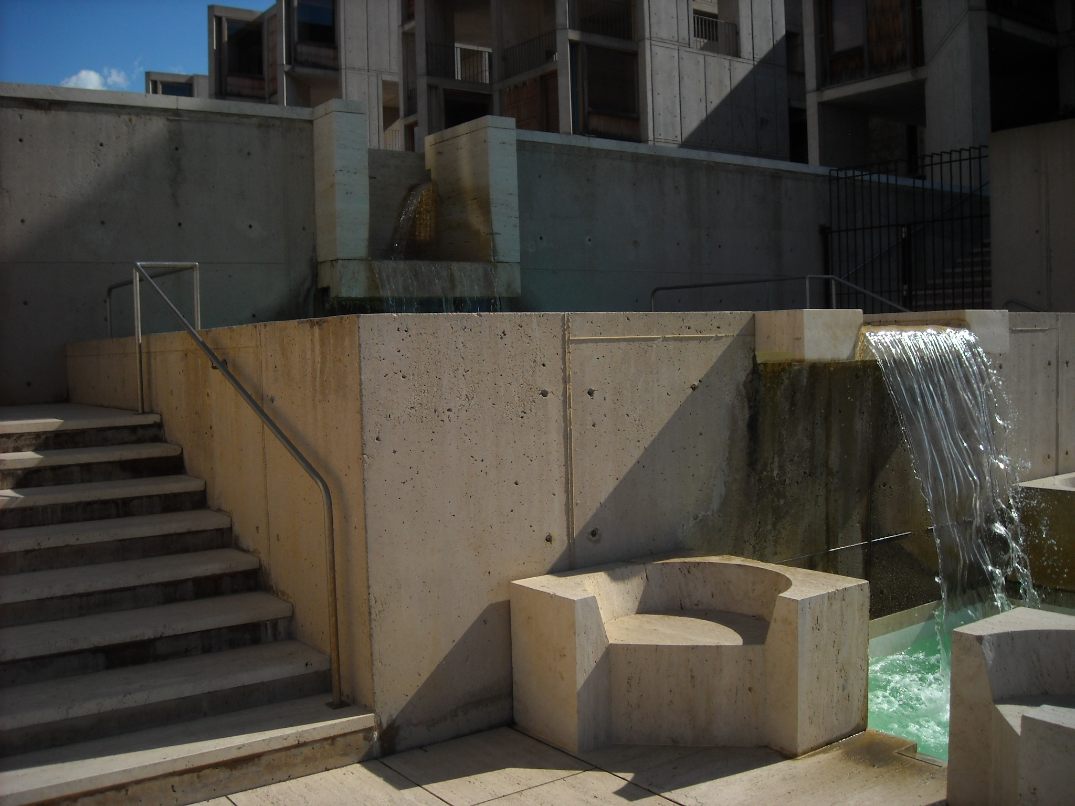
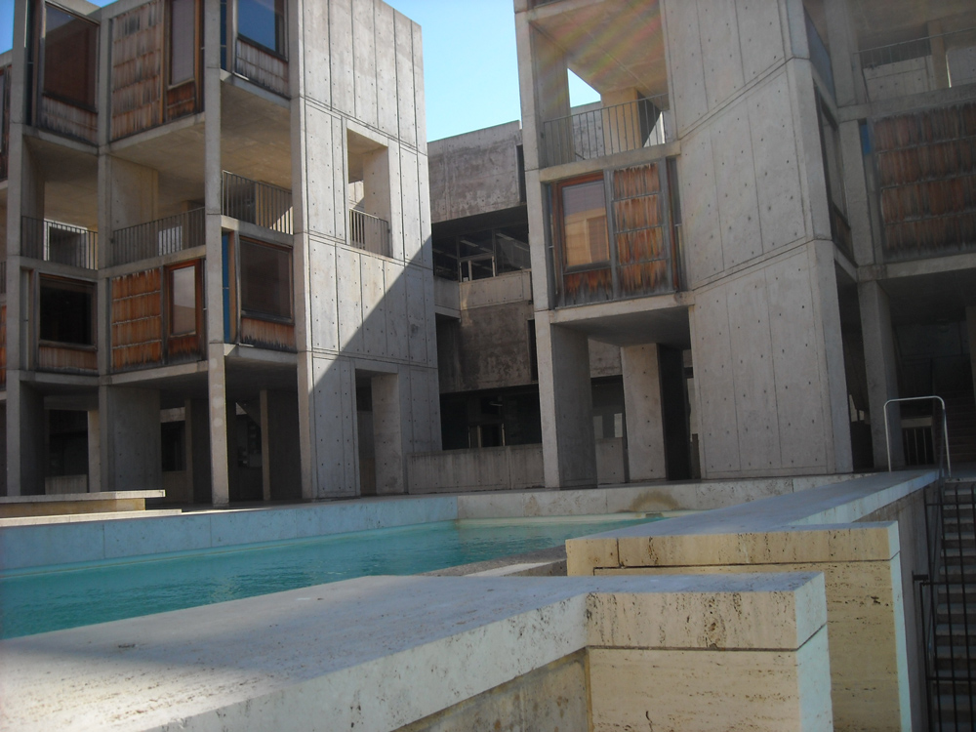
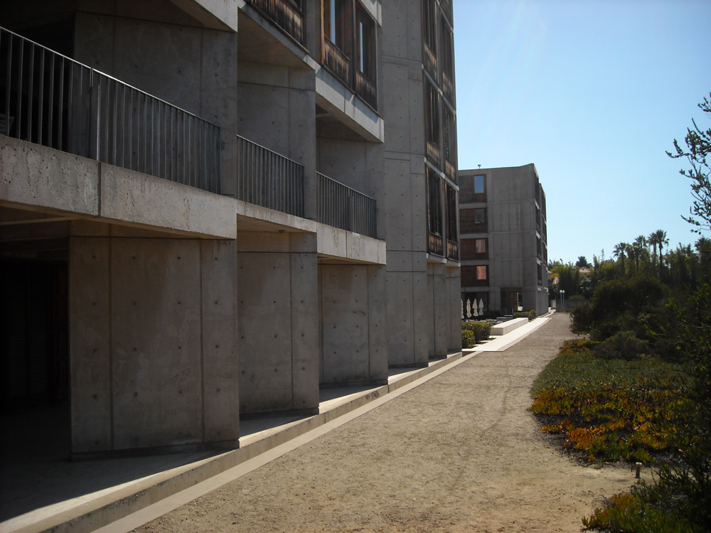
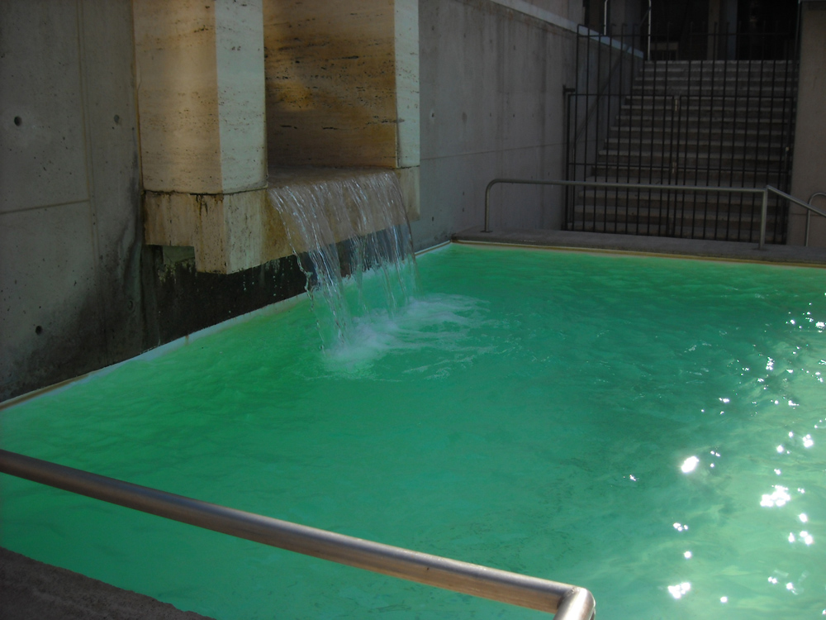
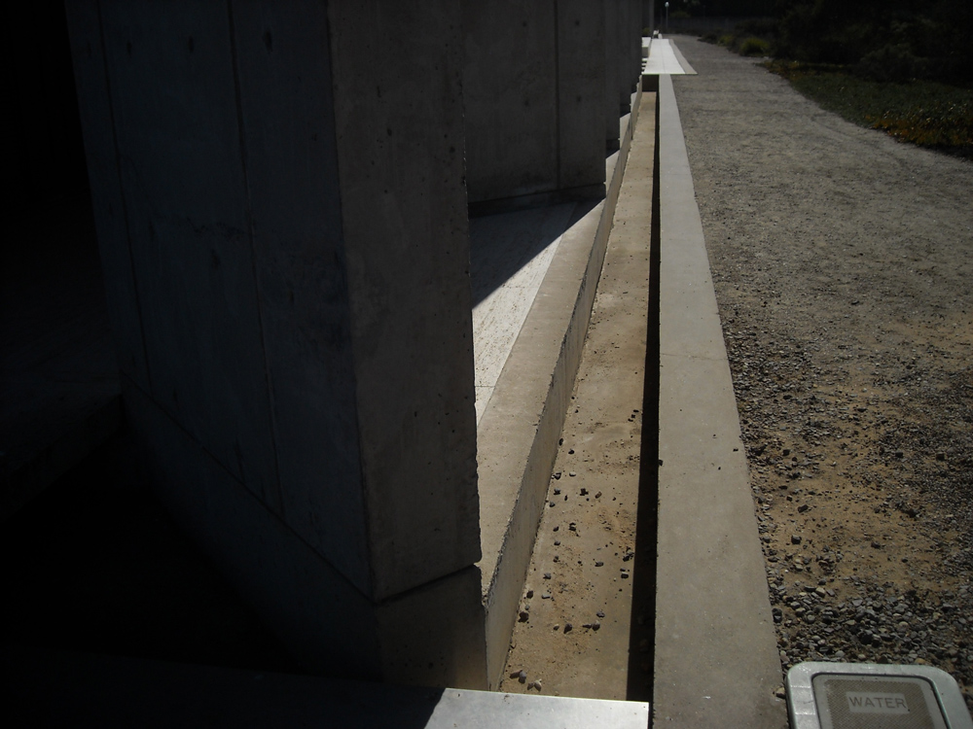
Water collection
Rainwater is collected and stored, fountains are maintained without additional water input in a climate with 8 inches per year average rainfall
Footnotes 1, 3,4,5

Slide 13
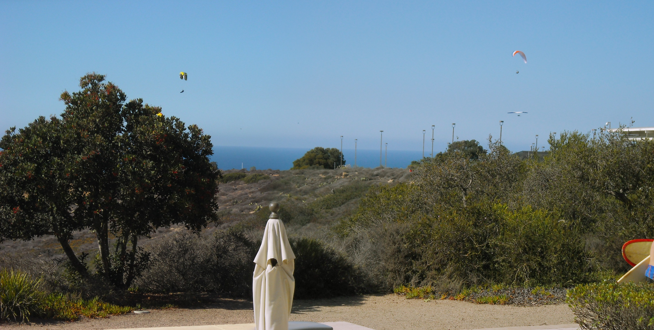
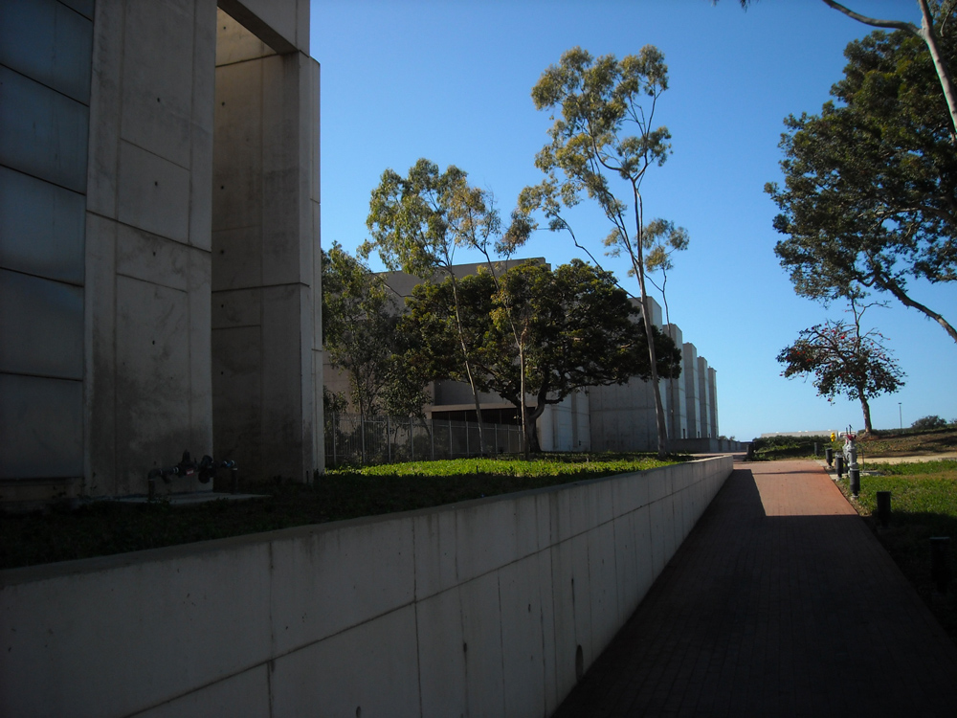
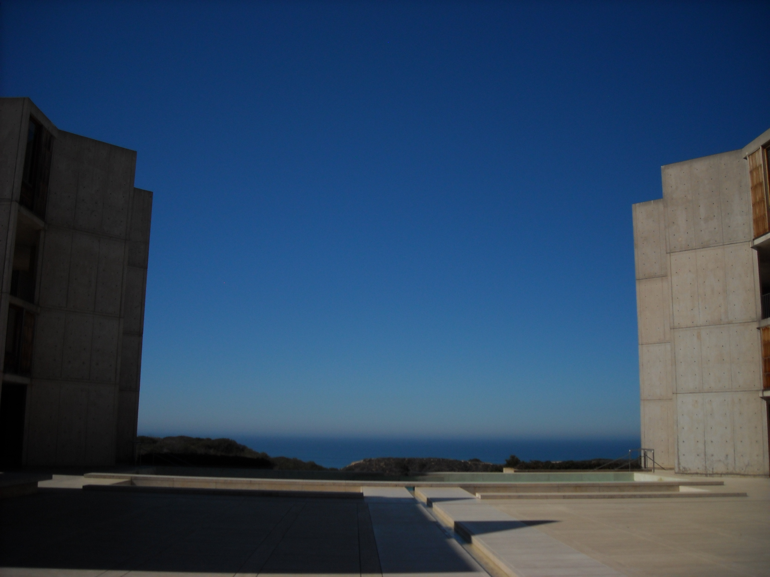
Influence of environment on the structure
The Mediterranean climate and coastal location provide a predominance of sunny days and comfortable temperatures.
The great working environment is baked into the design.
The flexibility of the lab spaces was designed into the concept with the use of column free space and interstitial spaces for all utilities.
Footnotes 1,4,5

Slide 14
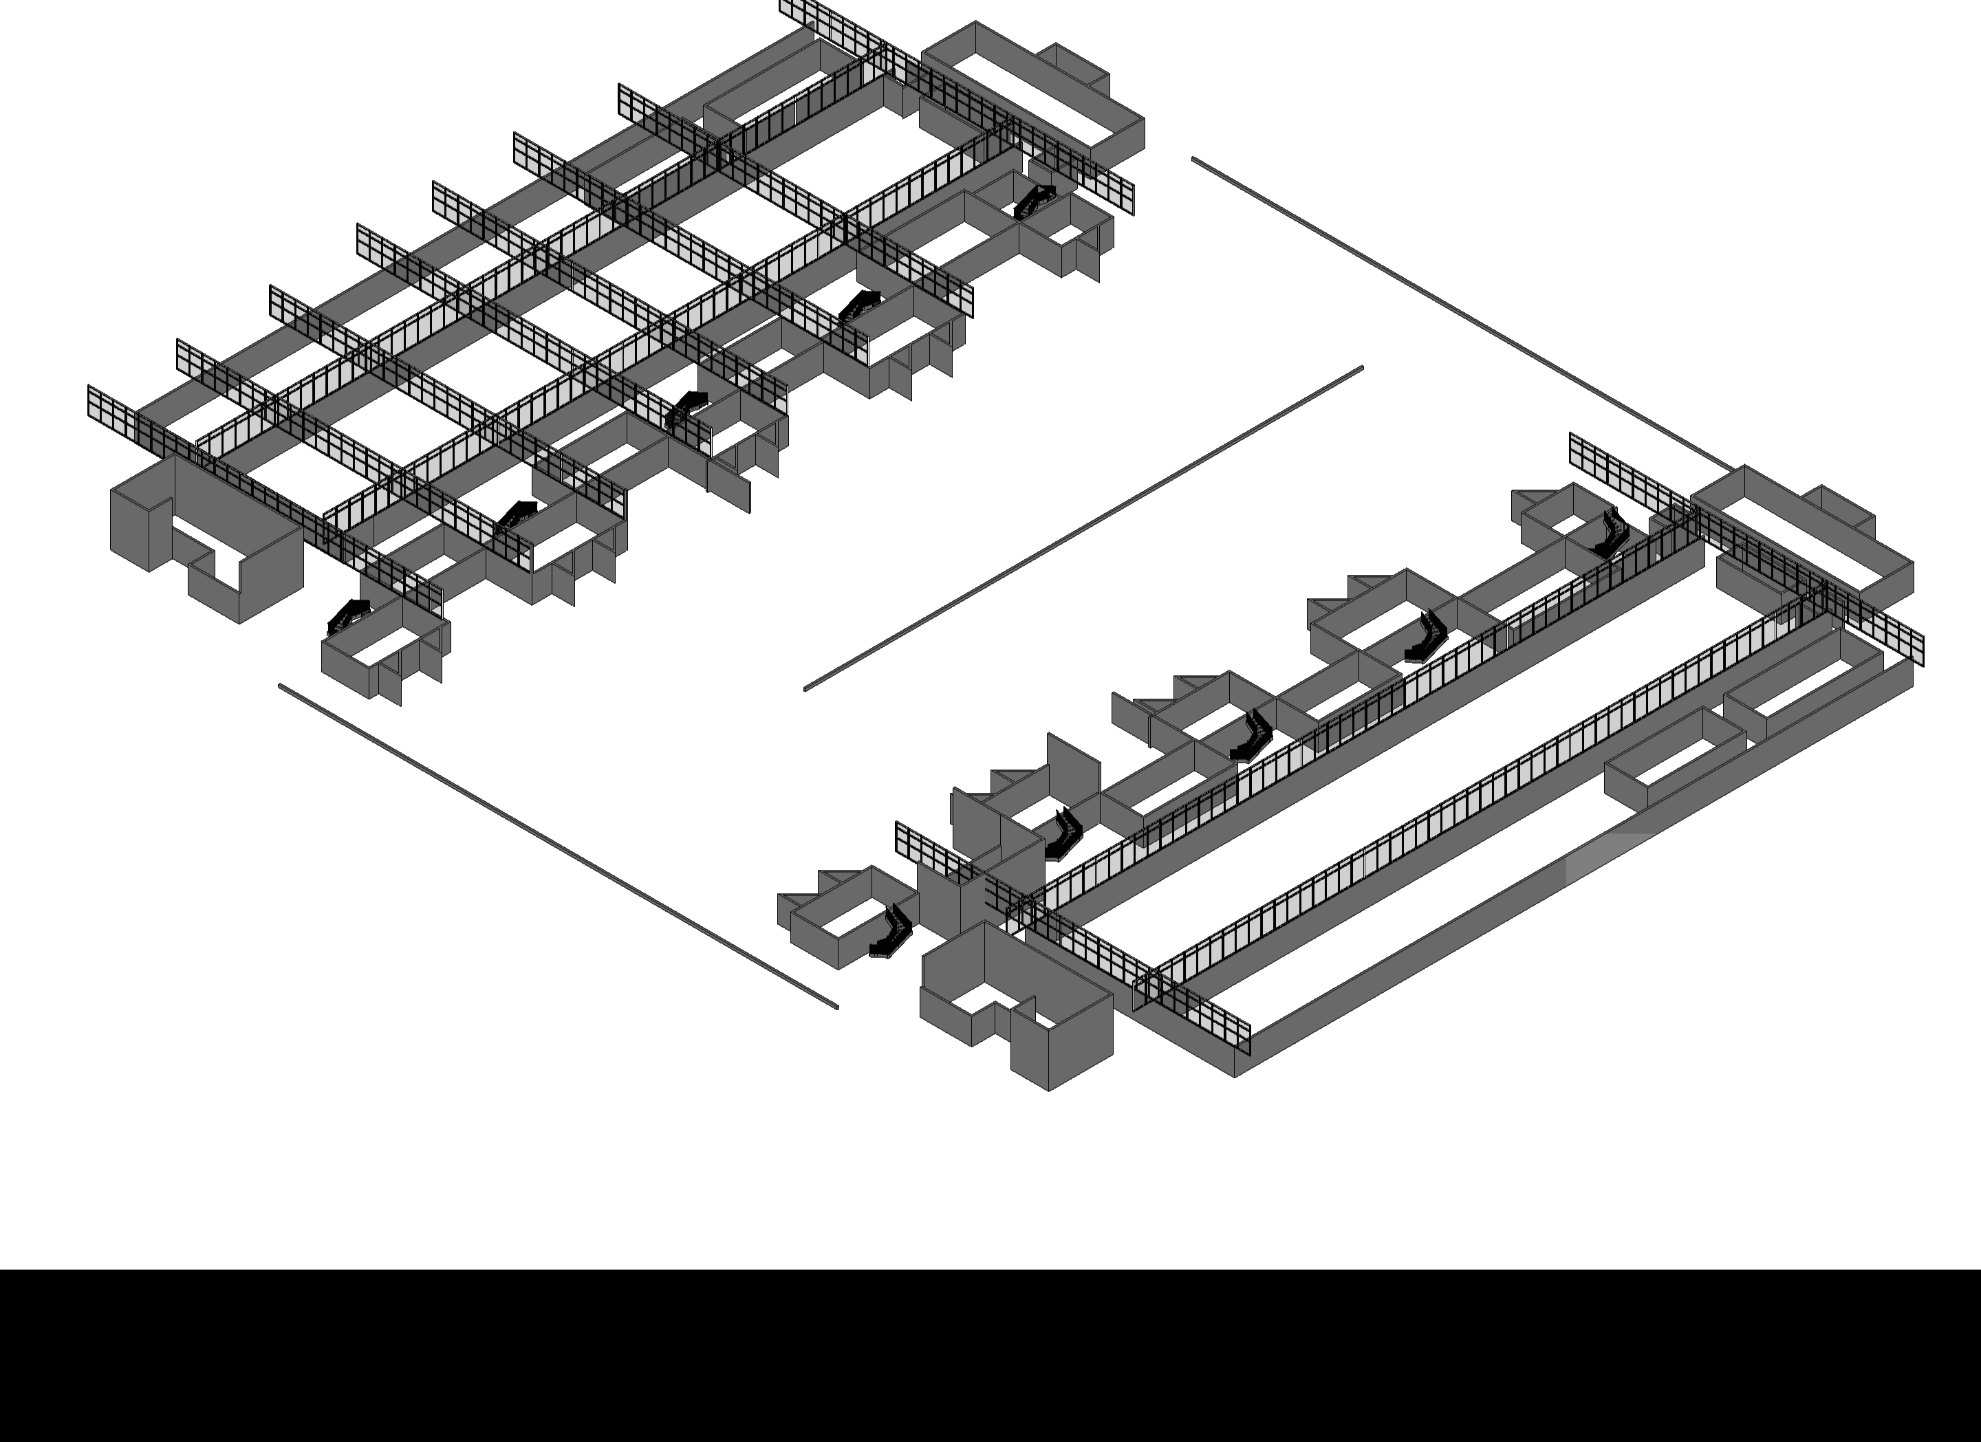
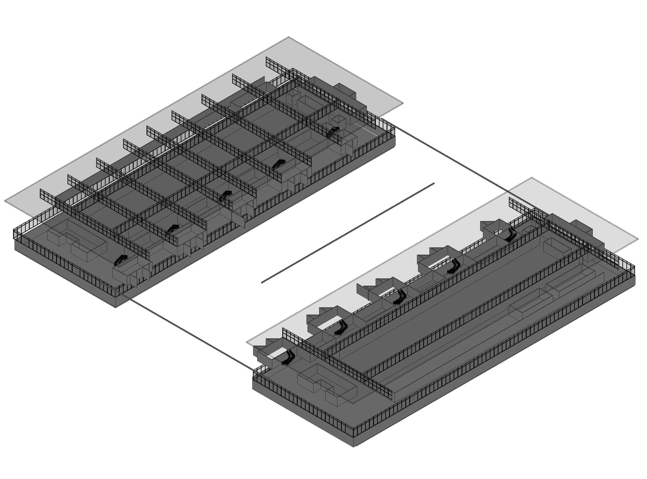
Organized spaces
Lab spaces are secure from public access. Post doctorate researchers have only a very small desk to work at.
Primary research scientists have offices in the office towers.
Service towers have elevators, restrooms, entrance gates and stairs.
Open lab spaces are easily and modularly reconfigured
Organized into service towers and office towers.
Office towers on inner courtyard
Offices are the oak table environment
Labs are the stainless steel environment
Service towers on exterior sides of buildings
Footnotes 1,4,5

Slide 15
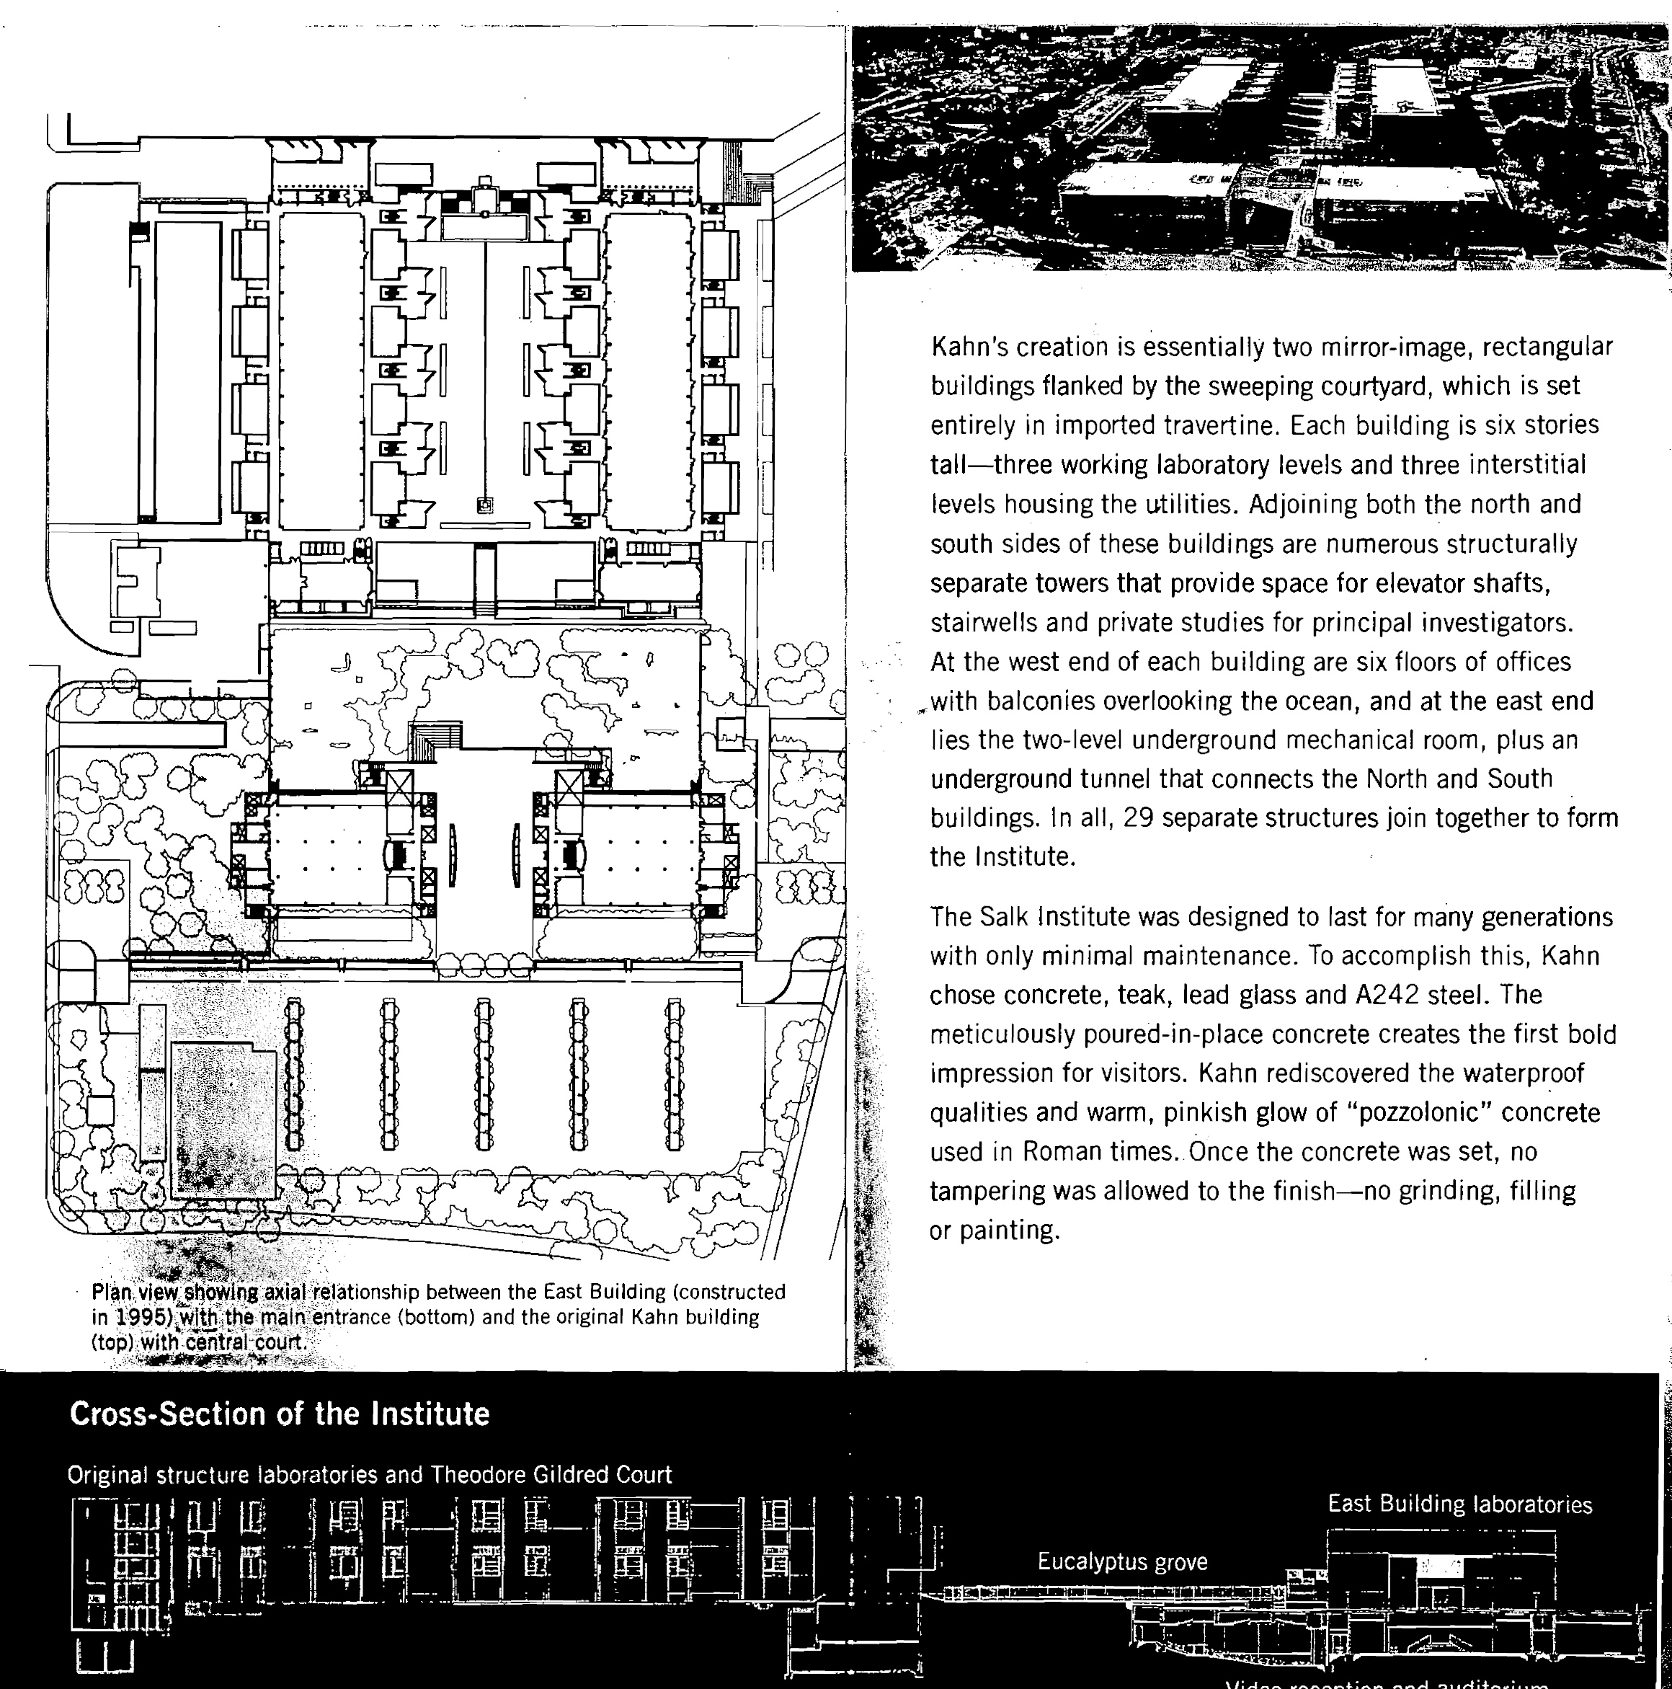
Site and building plans
Original buildings
North is to the right in this plan
1995 buildings
Footnotes 1,5,6

Slide 16
Remnant of Kahns’ Eucalyptus and fruit tree grove
The original feel of the site has been changed from the 1960 version. In 1995 the new east buildings were built and part of the serene grove pilgrimage experience was removed. The site was opened up in view to the main street.
Footnotes 1, 3, 5

Slide 17
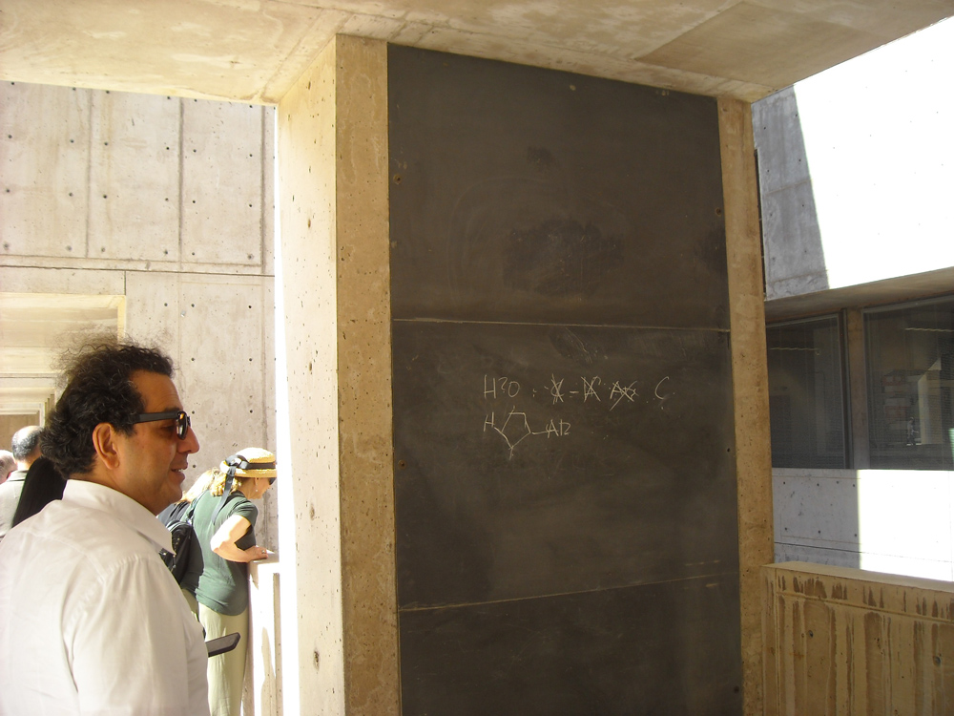
Chalkboards so scientists can share ideas in a time before email and computers
Footnotes 1, 4, 5

Slide 18
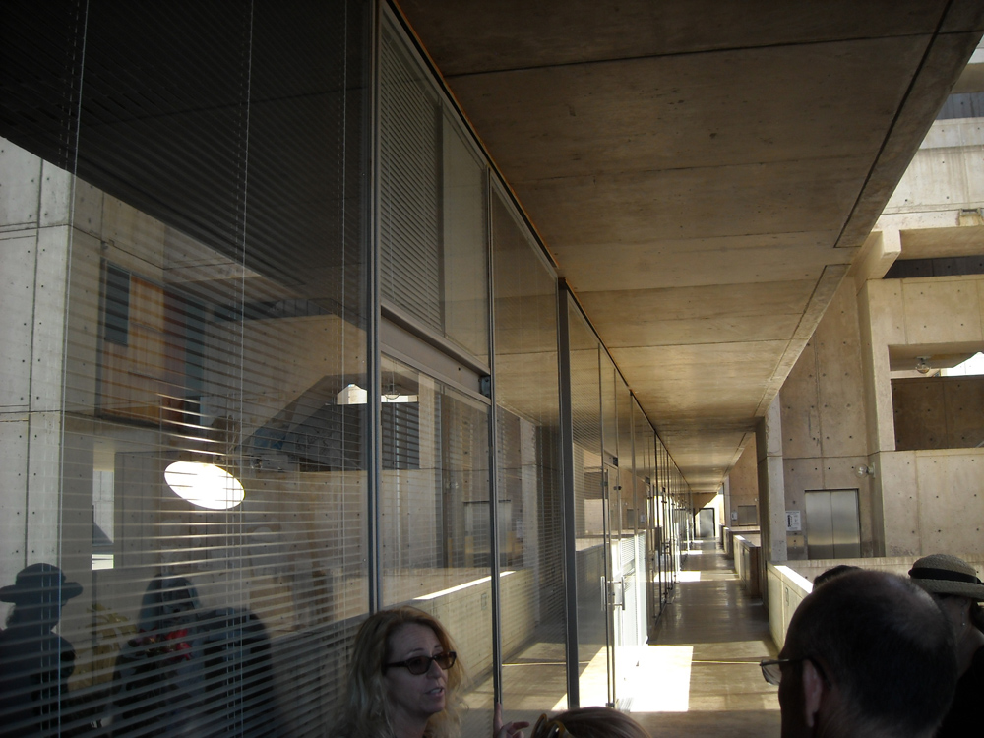
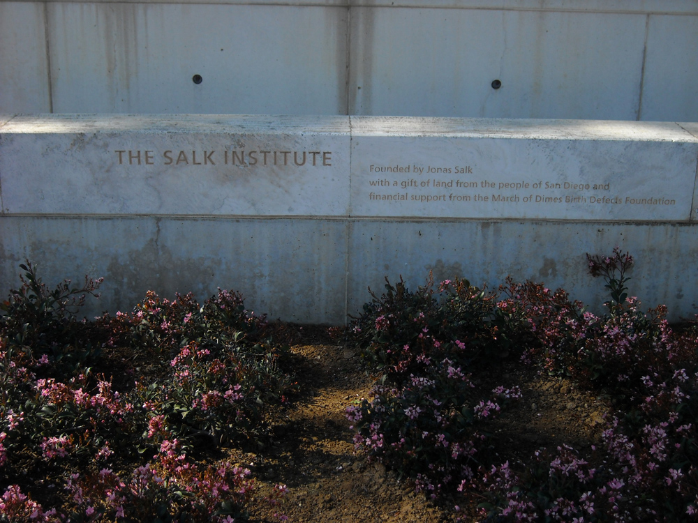
Historic Lineage
Kahn and Salk wanted an artistic monument for scientists to work in
Land donated by San Diego at the same time as UCSD, they “grew up” together, right across the road from each other.
Footnotes 1,4,5
Notes:
UCSD is the University of California San Diego

Slide 19
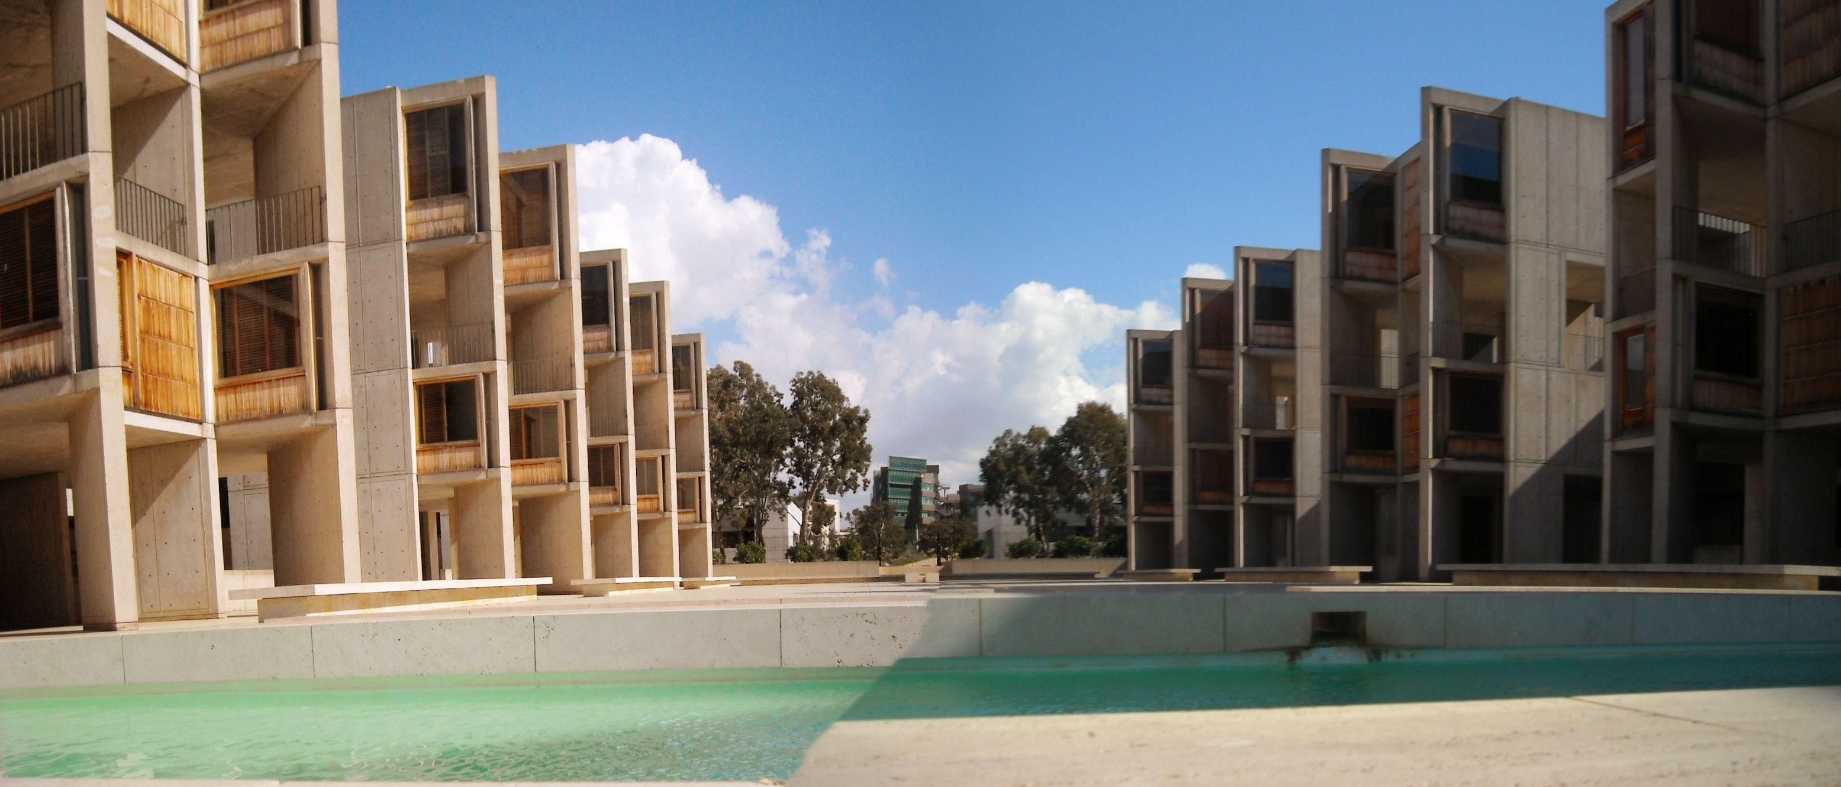
Salks’, Barragans’ and Kahn’s vision were realized in a research building that will excite the artist in all of us.
Footnotes 1, 2, 5
Notes:
Panorama made with Nikon Panorama maker 4

Slide 20
Ways to incorporate into professional work
Natural ventilation with courtyards and shady areas
Water collection and reuse
Permanent materials
Adapt to the site
Gather people together
Give people many little informal meeting spaces
Footnote 5

Slide 21
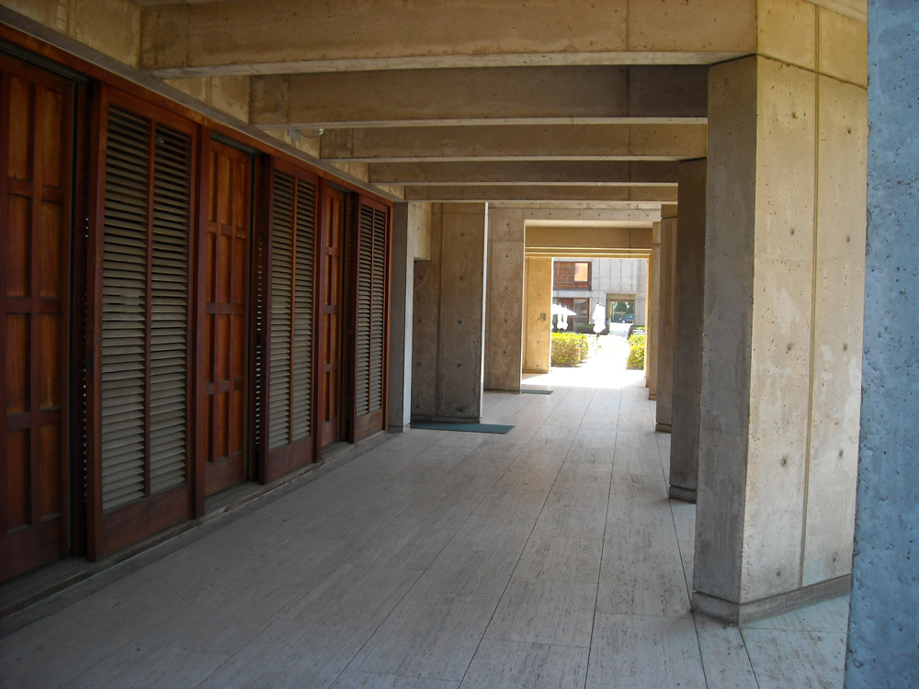
Historic source 1
Collonades based on classical proportions
Kahn wanted to mimic the proportion of classical Greek collanades
Footnotes 1, 3, 5, 9

Slide 22
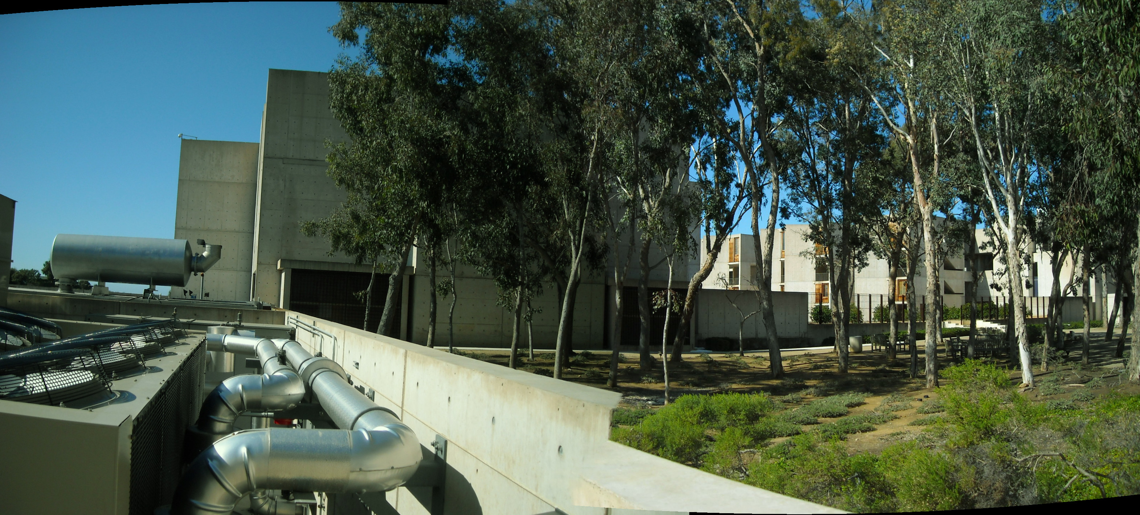
Historic source 2
Forest paths, a monastic path, plaza spaces and informal meeting areas increase connections between building users. Making memorable experiences out of an everyday walk from the parking lot helps the scientists connect with each other, incubate ideas and clear their minds.
The entry to the monastery at St. Francis Assisi influenced Salk and Kahn to create a pilgrim path thorough a eucalyptus grove from parking lot to the building entry they wanted to calm the mind and have a curved path to the building followed by steps up to the plaza to be uplifted when reaching the facility
Footnotes 1,4,5

Slide 23
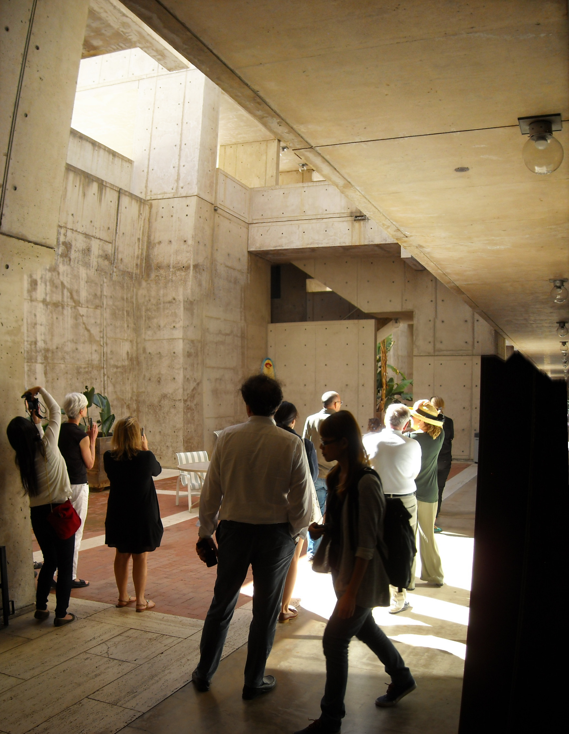
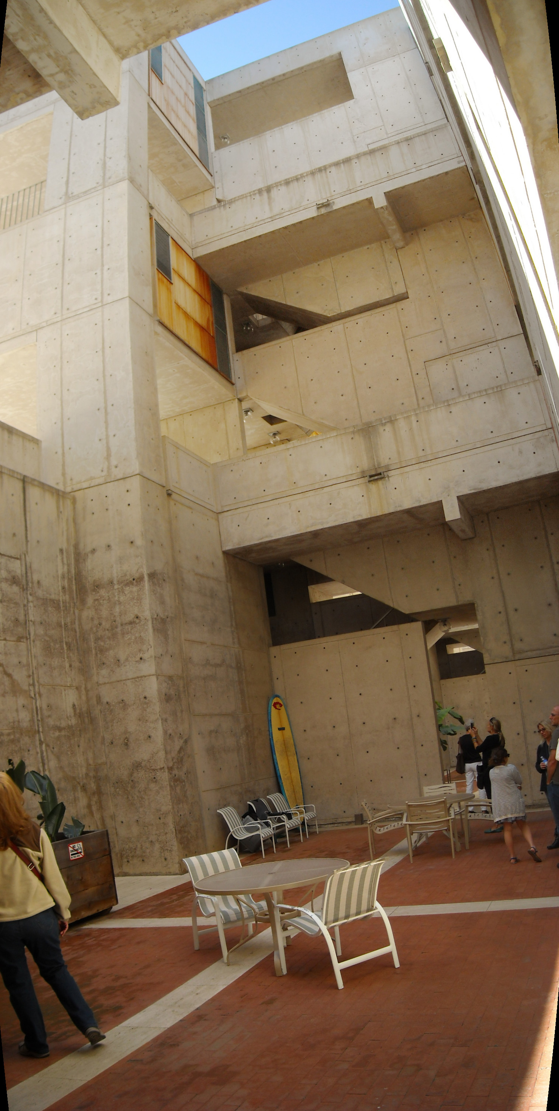
Historic source 3
Light wells bring air and sun into lower basement, creating an open airy, protected environment
Even the low basement was naturally lit and opened to the surface 3 stories above.
Salk did not want the lowest level to feel like a basement and cut off from all light and air.
The lab spaces are surrounded by open courtyards with outdoor tables where the researchers can meet, relax and store their surfboards.
The space feels very inviting and open.
Footnotes 1,4,5,10

Slide 24
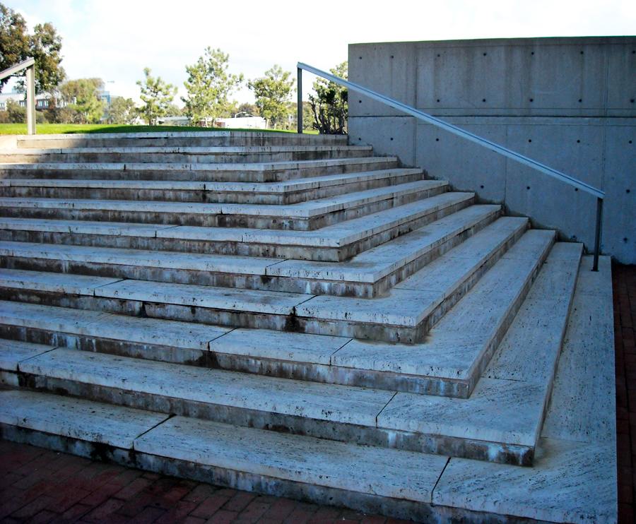
Sustainable reuse of travertine, concrete and teak
Their use of travertine is sustainable, it is easily replaceable.
It is unfilled and unsealed.
The original pieces were discovered by Salk himself.
They are sustainable due to being first used as ballast in ships then reused as the plaza material.
Concrete brutalist style cast in place walls require no maintenance.
The teak on the exterior is designed to be unsealed and age in the salty mist.
The form tie holes were sealed with caps designed by Kahn. His goal for the facility was to have no maintaining of paint for the life of the building.
Footnotes 1,3,4,5,6

Slide 25
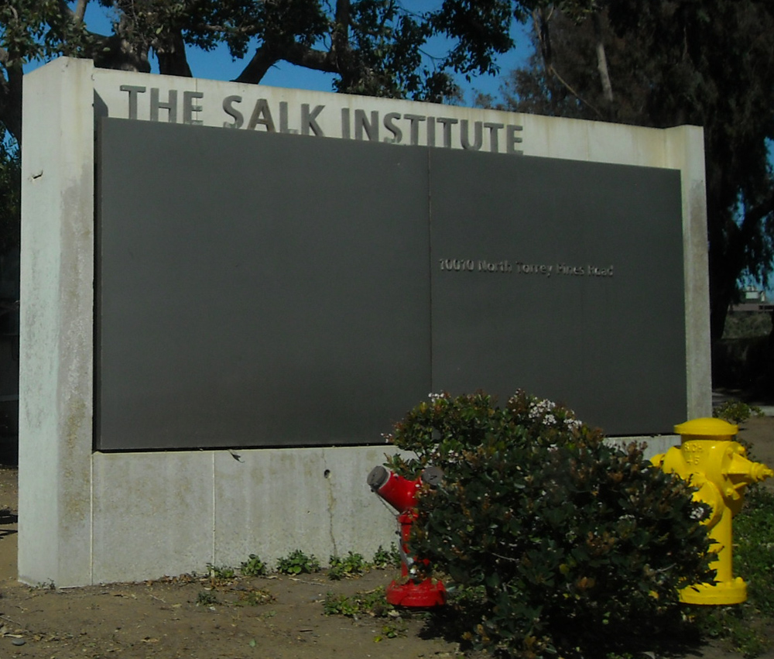
Footnotes
1. Photos, Photoshop work and Revit illustrations by Dennis Selke.
2. Photos by Marlene Selke
3. Site visit a1 on 2/1/14
4. Site visit a2 for interior tour 2/14/14
5. Salk Institute tour guide: Lilly, 2/14/14
6. Salk Institute brochures: 2/1/14
7. Salk Institute 2012 report
8. Retrieved from www.architect.architecture.sk, louis kahn, luis barragan
9. Retrieved from www.britannica.com, collanade
10. Retrieved from http://inhabitat.com/quarter-circle-light-wells-brighten-up-the-tiny-pedervegen-8-house-in-norway/pedervegen-8-by-rever-og-drage-arkitekter-04/?extend=1
Maps from Google Earth and National Weather Service as reflected in notes
Notes:
Photo by Dennis Selke 2/1/14

